Slide 1
Implementation of a Lending System

Slide 2
Definition
Lending System – By definition, a system that will allow us to provide credit to any customer who is in dire need at any time.
Customers can access this system via a mobile application or USSD code for example dial *Some code here # for example *222#
A sample flow is displayed in the next slide

Slide 3
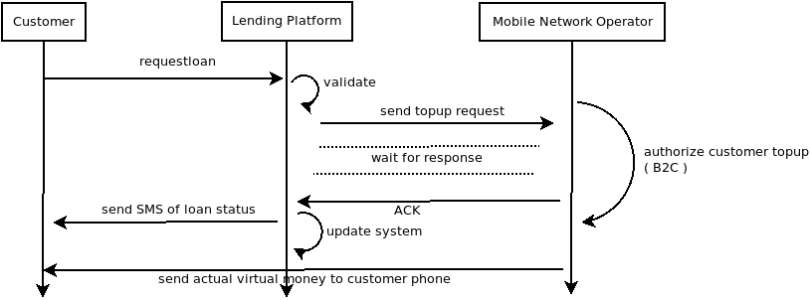
Get Loan flow ( USSD or Mobile App )

Slide 4
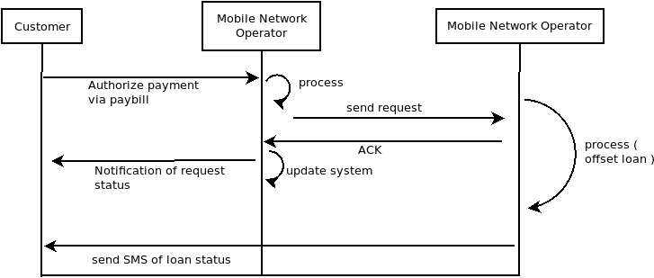
Pay Loan flow ( USSD or Mobile)

Slide 5
What functionalities will the system have ?
The main functionalities required for this system are as below:-
Register – self registration that is give us your profile/background like email, name, accept our terms ( k-y-c process )
Check Balance – a way for the customer to check their balance
Pay Loan – a way for the customer to repay their previous loan
Get Loan – a way for the customer to request for a loan

Slide 6
How does the architecture look like ?
So far we have the below components :-
USSD – means to access the service
API – access as a service by the USSD ( or APP ) Contains the actual functionalities like get-loan, pay-loan, register, check-balance. Restful JSON over HTTP
Background Applications – Requests to the API will be asynchronous
SMS – a way to notify customers of the loan request/payment process state
Management Portal – A way for system administrators to manage data or configurations or view micro-lending transactions.

Slide 7
What more do we require ?
Ideally we need exposure to a Credit Reference Bureau (CRB) such that anyone accessing the system with an aim of receiving credit has a credit worthy check first before we disburse funds to avoid high defaulting rate.
Hence, in addition to the previous components now we include the CRB component necessary for processing.
In the next slide we see the sample architecture

Slide 8
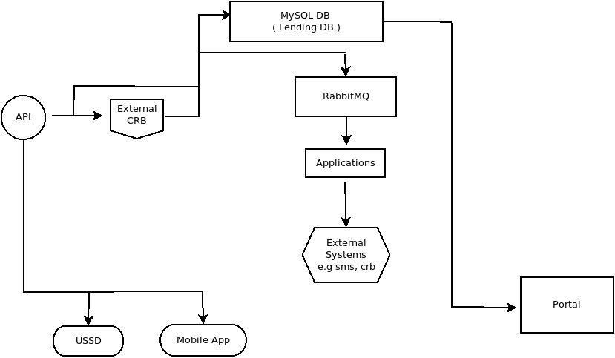
Architecture

Slide 9
Architecture - Technology Stack
We can break down the technology stack in the below list :-
Servers - Linux CentOs 6
API - Built on python using flask restful accepting only json format
External-CRB – Service provided by a Credit Reference bureau
Database - MySQL, a shared resource, which is replicated
Applications – background processing services built in Python ( Ver 2.7 )
Queues - High use of RabbitMQ ( replicated )

Slide 10
Architecture - Technology Stack
Deployment - is a manual process
Benchmarking API performance - ApacheBench (ab)

Slide 11
So what do we need from the business ?
We have Identified Safaricom as the pilot MNO we want to work with, so in order to deliver this product we check internally and we might ask :-
How many people do we need for this project ?
How many servers do we need ? Are we using dedicated cloud servers or local servers ? How long does it take to acquire the servers if we have none ?
If we do, do the servers have the necessary softwares installed ?
Do we have a connection/setup with an external CRB ?
Do we have VPN connectivity with the MNO ? (at least 1 day )

Slide 12
So what do we need from the business ?
Do we have the codes USSD, C2B and B2C setup on MNO ? (at least 3 weeks )
Do we have SMS setup and available units ?
In the next slide, we look at the time-lines to achieve this project.

Slide 13
Project Timelines
Task | No of resources | Owner | Days to Implement
VPN Acquisition, Setup | 3 | Business,MNO, Network Engineer | 2~4
USSD Acquisition, Setup | 3 | Business,MNO, Network Engineer | 2~4
C2B Acquisition, Setup | 3 | Business, MNO, Network Engineer | 2~4
B2C Acquisition, Setup | 3 | Business,MNO, Network Engineer | 2~4
Cloud Server Acquisition, Setup | 2 | Business, Systems Administrator | 1
lending Design | 2 | Engineers | 2

Slide 14
Project Timelines
Database | 2 | Engineers | 1
API ( functions ) | 1 | Engineer | 5 ( a day for each )
Applications | 1 | Engineer | 7 ( a day for each )
Administration Portal | 1 | Engineer | 4 ( a day for each view)
End to End Testing | 3 | 2 Engineer, 1 Business | 1
Quality Assurance Sign-off | 2 | Engineers | 1
Live Deployment | 2 | Engineers | 1
Monitoring ( Nagios, Grafana, influxDB ) | 1 | Engineer | 1

